Slide 1
EE126 Final Presentation
Snoopy Cache
Bradley Frizzell
Tufts University Department of Electrical and Computer Engineering
12/1/2014

Slide 2
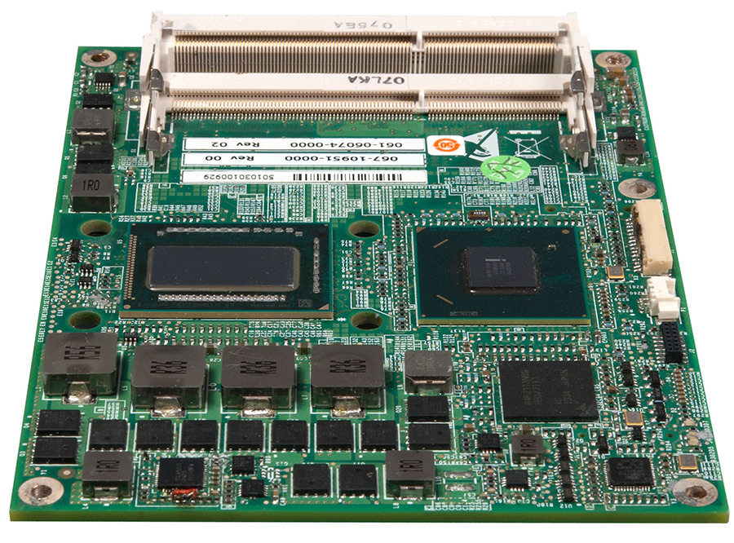
Multiprocessing^{[6]}
Computers now have multiple processors
Memory shared between multiple processors leads to high contention on memory bus
To increase speed, each processor needs its own private cache
What happens when multiple processors use the same memory?
http://www.radisys.com/wp-content/uploads/comexpress-CEQ67-FrontOblique.jpg
Notes:
As long as there have been computers, people have been going “man, my computer is too slow” [hit computer]

Slide 3
The Cache Coherence Problem
Processor 1
Cache 1
Memory
$1000
3A 4D 00 1B
22 11 4A 00
10 AA FF 04
BC D0 10 98
00 00 00 00
1A 1A 10 10
23 53 0A 0F
FF FF FF FF
$1004
$1008
$100C
$1010
Processor 2
Cache 2
$1014
$1018
$101C
Notes:
The memory can be any kind of memory for this problem to arise.

Slide 4
The Cache Coherence Problem
Processor 1
Cache 1
Memory
$1000
3A 4D 00 1B
22 11 4A 00
10 AA FF 04
BC D0 10 98
00 00 00 00
1A 1A 10 10
23 53 0A 0F
FF FF FF FF
3A 4D 00 1B
$1000
3A 4D 00 1B
FF FF FF FF
$1000
$1004
$1008
$100C
$1010
Processor 2
Cache 2
$1014
$1018
$101C
Notes:
The memory can be any kind of memory for this problem to arise.
----- Meeting Notes (11/30/14 16:33) -----
2:15 up to this point

Slide 5
Solutions
Software or Hardware?
Hardware is better!
The solution needs to ALWAYS be working.
There is no typical situation where having data out of sync is a good thing, so no reason to let that happen!
Notes:
Hardware is better because a programmer should not be thinking about the implementation of cache coherence. It needs to be totally invisible to the user.

Slide 6
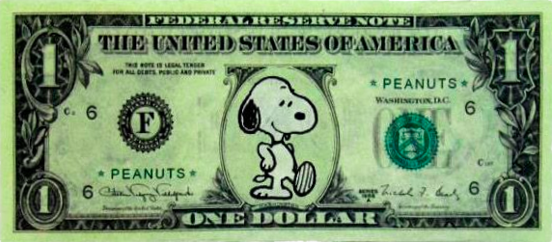
Solution:
Snoopy Cash
Snoopy Cache

Slide 7
Snoopy Cache
Each cache controller “snoops” on the shared memory bus to check for changes to blocks of memory it has a copy of
Based on low-latency and low-overhead broadcasts on shared memory bus when data is modified
http://media.merchantcircle.com/6203953/Snoopy-Computer_full.jpeg

Slide 8
Snoopy Cache Coherence Protocol
Write-Invalidate
When new data is written, all other copies in all other caches are invalidated
“Passive”
e.g. Berkeley, Illionois, Write-Once
Write-Broadcast / Write-Update
When new data is written, update all other cached copies
“Active”
e.g. Firefly, Dragon
Notes:
There are two main kinds of snoopy cache coherence protocols. Write invalidate, and Write-Broadcast, also known as write-update.

Slide 9
Write-Once^{[1][6]}
First snoopy cache protocol described.
Four possible states for a memory block in cache
INVALID
VALID
RESERVED
DIRTY
Multiple memory readers allowed simultaneously, not multiple writers
Notes:
Invalid – data is not up to date at all, can not be used
Valid (not modified from what is in memory, and possibly shared across multiple caches)
Reserved (Not needing a write-back, and guaranteed to be the only copy of that block in any cache, like VALID but the only copy)
Dirty (Written more than once, and the only copy in any cache)

Slide 10
Write Once Protocol
Write Hit
Scenario 1

Slide 11
Write Once Protocol
Write Hit
Scenario 1
CACHE 1
CACHE 2
CACHE 3
$1000 | DIRTY | 0x00000000
$1000 Write Hit
$1000 | 0xA1B2C3D4
MEMORY
Notes:
If the block is already dirty, then the write proceeds locally in the cache

Slide 12
Write Once Protocol
Write Hit
Scenario 1
CACHE 1
CACHE 2
CACHE 3
$1000 | DIRTY | 0xFFFFFFFF
$1000 Write Hit
$1000 | 0xA1B2C3D4
MEMORY

Slide 13
Write Once Protocol
Write Hit
Scenario 2

Slide 14
Write Once Protocol
Write Hit
Scenario 2
CACHE 1
CACHE 2
CACHE 3
$1000 | RSRVD | 0xA1B2C3D4
$1000 Write Hit
$1000 | 0xA1B2C3D4
MEMORY
Notes:
If the block is reserved, it changes to dirty and proceeds locally

Slide 15
Write Once Protocol
Write Hit
Scenario 2
CACHE 1
CACHE 2
CACHE 3
$1000 | DIRTY | 0xFFFFFFFF
$1000 Write Hit
$1000 | 0xA1B2C3D4
MEMORY
Notes:
No cache has a dirty copy of that memory

Slide 16
Write Once Protocol
Write Hit
Scenario 3

Slide 17
Write Once Protocol
Write Hit
Scenario 3
CACHE 1
CACHE 2
CACHE 3
$1000 | VALID | 0xA1B2C3D4
$1000 | VALID | 0xA1B2C3D4
$1000 | VALID | 0xA1B2C3D4
$1000 Write Hit
$1000 | 0xA1B2C3D4
MEMORY
Notes:
If it is valid, it gets written through to memory, and all other instances change to INVALID

Slide 18
Write Once Protocol
Write Hit
Scenario 3
CACHE 1
CACHE 2
CACHE 3
$1000 | RSRVD | 0xFFFFFFFF
$1000 | INVLD | 0xA1B2C3D4
$1000 | INVLD | 0xA1B2C3D4
$1000 Write Hit
$1000 | 0xFFFFFFFF
MEMORY

Slide 19
Firefly Protocol^{[1]}
Developed for the Firefly, a multiprocessor workstation developed by Digital Equipment Corporation
Utilizes a special bus line to detect sharing, called the SharedLine
States:
VALID-EXCLUSIVE
SHARED
DIRTY
Notes:
VALID-EXCLUSIVE : not modified, and the only copy in any cache
SHARED : not modified, and other caches may have a copy.
DIRTY : modified, and only copy in any cache

Slide 20
Firefly Protocol
Write Hit
Scenario 1

Slide 21
Firefly Protocol
Write Hit
Scenario 1
CACHE 1
CACHE 2
CACHE 3
$1000 | DIRTY | 0x10101010
$1000 Write Hit
SharedLine
Memory Bus
$1000 | 0xA1B2C3D4
MEMORY
Notes:
If the block is dirty, the write can happen immediately

Slide 22
Firefly Protocol
Write Hit
Scenario 1
CACHE 1
CACHE 2
CACHE 3
$1000 | DIRTY | 0xAAAAAAAA
$1000 Write Hit
SharedLine
Memory Bus
$1000 | 0xA1B2C3D4
MEMORY
Notes:
If the block is dirty, the write can happen immediately

Slide 23
Firefly Protocol
Write Hit
Scenario 2

Slide 24
Firefly Protocol
Write Hit
Scenario 2
CACHE 1
CACHE 2
CACHE 3
$1000 | VLDEX | 0xA1B2C3D4
$1000 Write Hit
SharedLine
Memory Bus
$1000 | 0xA1B2C3D4
MEMORY
Notes:
If the block is VALID-EXCLUSIVE, the write can happen immediately

Slide 25
Firefly Protocol
Write Hit
Scenario 3
CACHE 1
CACHE 2
CACHE 3
$1000 | DIRTY | 0xAAAAAAAA
$1000 Write Hit
SharedLine
Memory Bus
$1000 | 0xA1B2C3D4
MEMORY
Notes:
State changed to DIRTY

Slide 26
Firefly Protocol
Write Hit
Scenario 3

Slide 27
Firefly Protocol
Write Hit
Scenario 3
CACHE 1
CACHE 2
CACHE 3
$1000 | SHARE | 0xA1B2C3D4
$1000 | SHARE | 0xA1B2C3D4
$1000 | SHARE | 0xA1B2C3D4
$1000 Write Hit
SharedLine
Memory Bus
$1000 | 0xA1B2C3D4
MEMORY
Notes:
If the block is SHARED, then a write to memory is initiated, so first the bus is acquired

Slide 28
Firefly Protocol
Write Hit
Scenario 3
CACHE 1
CACHE 2
CACHE 3
$1000 | SHARE | 0xAAAAAAAA
$1000 | SHARE | 0xA1B2C3D4
$1000 | SHARE | 0xA1B2C3D4
$1000 Write Hit
SharedLine
Memory Bus
$1000 | 0xAAAAAAAA
MEMORY
Notes:
Then, any caches snooping on the bus will also update their memory

Slide 29
Firefly Protocol
Write Hit
Scenario 3
CACHE 1
CACHE 2
CACHE 3
$1000 | SHARE | 0xAAAAAAAA
$1000 | SHARE | 0xAAAAAAAA
$1000 | SHARE | 0xAAAAAAAA
$1000 Write Hit
SharedLine
Memory Bus
$1000 | 0xAAAAAAAA
MEMORY
Notes:
Then, any caches snooping on the bus will also update their memory
These caches then all raise the shared line
The initial cache doing the writing checks the SharedLine to assure that the memory is indeed shared. If it is, then it remains in state SHARED.

Slide 30
Firefly Protocol
Write Hit
Scenario 3B
CACHE 1
CACHE 2
CACHE 3
$1000 | SHARE | 0xAAAAAAAA
$1000 Write Hit
SharedLine
Memory Bus
$1000 | 0xAAAAAAAA
MEMORY
Notes:
If the other caches did not actually contained shared copies of the memory any more, then when Cache 1 checked the sharedLine, it would change to VALID-EXCLUSIVE

Slide 31
Firefly Protocol
Write Hit
Scenario 3B
CACHE 1
CACHE 2
CACHE 3
$1000 | VLDEX | 0xAAAAAAAA
$1000 Write Hit
SharedLine
Memory Bus
$1000 | 0xAAAAAAAA
MEMORY
Notes:
If the other caches did not actually contained shared copies of the memory any more, then when Cache 1 checked the sharedLine, it would change to VALID-EXCLUSIVE

Slide 32
Comparison
Write-Once
Firefly
Less hardware
Designed to use existing hardware in already made processors
Requires dedicated SharedLine
Needs less clock cycles to maintain updated data
Typically faster

Slide 33
What’s next?
Better support for large amounts of processors
Coherence protocols that do not rely on using the shared bus as frequently
Scalability

Slide 34
What’s next?
Directory Based Cache Coherence^{[4]}
Maintain a directory of the information that is in use across memory locations
Bring data to whichever processor needs it
Execution Migration Based Coherence^{[4]}
Bring the computation to the data
Dependable Cache Coherence^{[4]}
Combines Directory and Execution Migration
Caches can switch between either as a form of redundancy

Slide 35
Snoopy Cache Conclusions
Good for small number of processors^{[5]}
Main benefit is simplicity of design
Not scalable
Focused on specific state transitions, and does not have redundancy.
http://teacherweb.com/MA/BerkleyCommunitySchool/MrsDiMascio/Snoopy_Geeky_Red_Shirt.jpg

Slide 36
Works Cited
Archibald, James, and Jean-Loup Baer. "Cache Coherence Protocols: Evaluation Using a Multiprocessor Simulation Model." ACM Transactions on Computer Systems 4.4 (1986): 273-98. Implicitly Parallel Architectures Group. University of Illinois. Web. 28 Nov. 2014.
Dahlgren, Fredrik, Jonas Skeppstedt, and Per Stenström. "An Evaluation of Hardware-based and Compiler-controlled Optimizations of Snooping Cache Protocols." Future Generation Computer Systems 13.6 (1998): 469-87. Web.
Karlin, Anna R., Mark S. Manasse, Larry Rudolph, and Daniel D. Sleator. "Competitive Snoopy Caching." Algorithmica 3.1-4 (1988): 79-119. Web.
Khan, Omer, Mieszko Lis, Yildiz Sinangil, and Srinivas Devadas. "DCC: A Dependable Cache Coherence Multicore Architecture." IEEE Computer Architecture Letters 10.1 (2011): 12-15. Web.
Lin, Jingmei, et. Al. "A New Kind of Hybrid Cache Coherence Protocol for Multiprocessor with D-Cache." Proc. of 2011 International Conference on Future Computer Science and Education, Hi'an, China. IEEE. IEEE Xplore. IEEE. Web. 29 Nov. 2014.
Ravishankar, C. V., and J. R. Goodman. "Cache Implementation for Multiple Microprocessors." Proc. of IEEE CompCon, San Francisco, CA. IEEE. 346-50. IEEE. Web. 29 Nov. 2014.
Tomasevic, Milo, and Veljko Milutinović. "A Simulation Study of Snoopy Cache Coherence Protocols." Proceedings of the Twenty-fifth Hawaii International Conference on System Sciences. Kauai, HI. IEEE. 427-36. IEEE Xplore. IEEE. Web. 30 Nov. 2014.

Slide 37
Questions?
EE126
http://fc05.deviantart.net/fs71/f/2013/093/f/a/snoopy_teaching_math_by_sakurapetalwolf-d609pot.jpg

Slide 38
Write-Once
Read hit : Data is in cache, success!
Read miss :
If no other cache has a DIRTY copy, then read from memory, state set to RESERVED
If any cache has a DIRTY copy, that copy is supplied, and is also written back to memory, all copies’ state set to VALID

Slide 39
Write-Once
Write Hit:
If the block state is DIRTY, write proceeds locally in cache
If the block state is RESERVED, write proceeds locally in cache, but state is set to DIRTY
If the block state is VALID, word is written through to memory, and state is changed to RESERVED. Other caches with the same block observe this bus write, and change their states to INVALID

Slide 40
Write-Once
Write Miss:
If no other cache has a DIRTY copy, then read from memory, state set to RESERVED
If some cache has a DIRTY copy, the block is loaded in the from the cache with DIRTY copy, and that cache invalidates
Then, proceed with write, and the state is set to DIRTY

Slide 41
Write Once Protocol
Read Miss
Scenario 1

Slide 42
Write Once Protocol
Read Miss
Scenario 1
CACHE 1
CACHE 2
CACHE 3
$1000 Read Miss
$1000 | VALID | 0xA1B2C3D4
$1000 | VALID | 0xA1B2C3D4
$1000 | 0xA1B2C3D4
MEMORY
Notes:
No cache has a dirty copy of that memory

Slide 43
Write Once Protocol
Read Miss
Scenario 1
CACHE 1
CACHE 2
CACHE 3
$1000 | VALID | 0xA1B2C3D4
$1000 | VALID | 0xA1B2C3D4
$1000 | VALID | 0xA1B2C3D4
$1000 | 0xA1B2C3D4
MEMORY
Notes:
Thus, it gets loaded in from memory.

Slide 44
Write Once Protocol
Read Miss
Scenario 2

Slide 45
Write Once Protocol
Read Miss
Scenario 2
CACHE 1
CACHE 2
CACHE 3
$1000 Read Miss
$1000 | DIRTY | 0xFFFFFFFF
$1000 | 0xA1B2C3D4
MEMORY
Notes:
Cache 2 Has a dirty copy of the memory

Slide 46
Write Once Protocol
Read Miss
Scenario 2
CACHE 1
CACHE 2
CACHE 3
$1000 | VALID | 0xFFFFFFFF
$1000 | VALID | 0xFFFFFFFF
$1000 | 0xFFFFFFFF
MEMORY
Notes:
The copy in Cache 2 gets written to memory, and to Cache 1.

Slide 47
Write Once Protocol
Write Miss
Scenario 1

Slide 48
Write Once Protocol
Write Miss
Scenario 1
CACHE 1
CACHE 2
CACHE 3
$1000 Write Miss
$1000 | VALID | 0xA1B2C3D4
$1000 | VALID | 0xA1B2C3D4
$1000 | 0xA1B2C3D4
MEMORY
Notes:
If there is a miss, and no other caches are dirty, it is loaded in from memory

Slide 49
Write Once Protocol
Write Miss
Scenario 1
CACHE 1
CACHE 2
CACHE 3
$1000 | VALID | 0xA1B2C3D4
$1000 | INVLD | 0xA1B2C3D4
$1000 | INVLD | 0xA1B2C3D4
$1000 | 0xA1B2C3D4
MEMORY
Notes:
All other instances are invalidated

Slide 50
Write Once Protocol
Write Miss
Scenario 1
CACHE 1
CACHE 2
CACHE 3
$1000 | DIRTY | 0xFFFFFFFF
$1000 | INVLD | 0xA1B2C3D4
$1000 | INVLD | 0xA1B2C3D4
$1000 | 0xA1B2C3D4
MEMORY
Notes:
Write occurs, and state is changed to dirty

Slide 51
Write Once Protocol
Write Miss
Scenario 2

Slide 52
Write Once Protocol
Write Miss
Scenario 2
CACHE 1
CACHE 2
CACHE 3
$1000 Write Miss
$1000 | DIRTY | 0xFFFFFFFF
$1000 | INVLD | 0xA1B2C3D4
$1000 | 0xA1B2C3D4
MEMORY
Notes:
If there exists a dirty copy, that gets copied in

Slide 53
Write Once Protocol
Write Miss
Scenario 2
CACHE 1
CACHE 2
CACHE 3
$1000 | DIRTY | 0xFFFFFFFF
$1000 | INVLD | 0xFFFFFFFF
$1000 | INVLD | 0xA1B2C3D4
$1000 | 0xA1B2C3D4
MEMORY
Notes:
The original dirty copy invalidates

Slide 54
Write Once Protocol
Write Miss
Scenario 2
CACHE 1
CACHE 2
CACHE 3
$1000 | DIRTY | 0x00000000
$1000 | INVLD | 0xFFFFFFFF
$1000 | INVLD | 0xA1B2C3D4
$1000 | 0xA1B2C3D4
MEMORY
Notes:
The write occurs.
----- Meeting Notes (11/30/14 16:33) -----
7:15 up to here

